Slide 1
Learning Objective
I will be able to solve simple problems involving probability experiment
Success Criteria
At the end of the lesson, I will be able to:
know the definition of probability;
know the following terms: sample space; event; experiment; trial, outcome and equally likely outcomes.
be able to calculate the probability of simple and compound events, given a sample space;
be able to calculate probability from set theory (link between ‘AND’ and intersection, ‘OR’ and union and ‘NOT’ and complement);and
be able to solve simple problems involving probability experiment.

Slide 2
Definitions
Activating Prior Knowledge
Experiment – any act that can be repeated under a set of given conditions.
Outcome – the result of an experiment. (Can be favourable or unfavourable.)
Sample space – the set of all possible outcomes of an experiment.
Event – any subset of the sample space, including the empty set.
Equally likely outcome - those events in a sample space who have same chance or same likelihood of occurrence

Slide 3
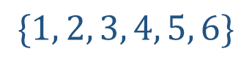
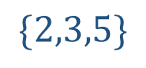
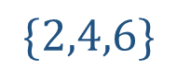
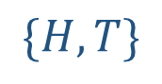
Guided Practice
List the sample space of a die: List the sample space of tossing a coin:
List the outcomes of rolling an even number on a die:
List the outcomes of rolling a prime number:
$$\{1, 2, 3, 4, 5, 6\}$$
$$\{H,T\}$$
$$\{2,4,6\}$$
$$\{2,3,5\}$$

Slide 4
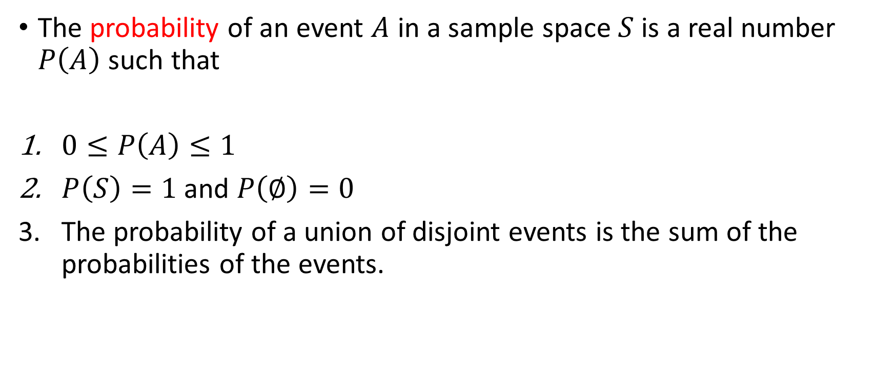
Probability
Concept Development
The probability of an event $A$ in a sample space $S$ is a real number $P\left(A\right)$ such that
$0≤P\left(A\right)≤1$
$P\left(S\right)=1$ and $P\left(∅\right)=0$
The probability of a union of disjoint events is the sum of the probabilities of the events.

Slide 5
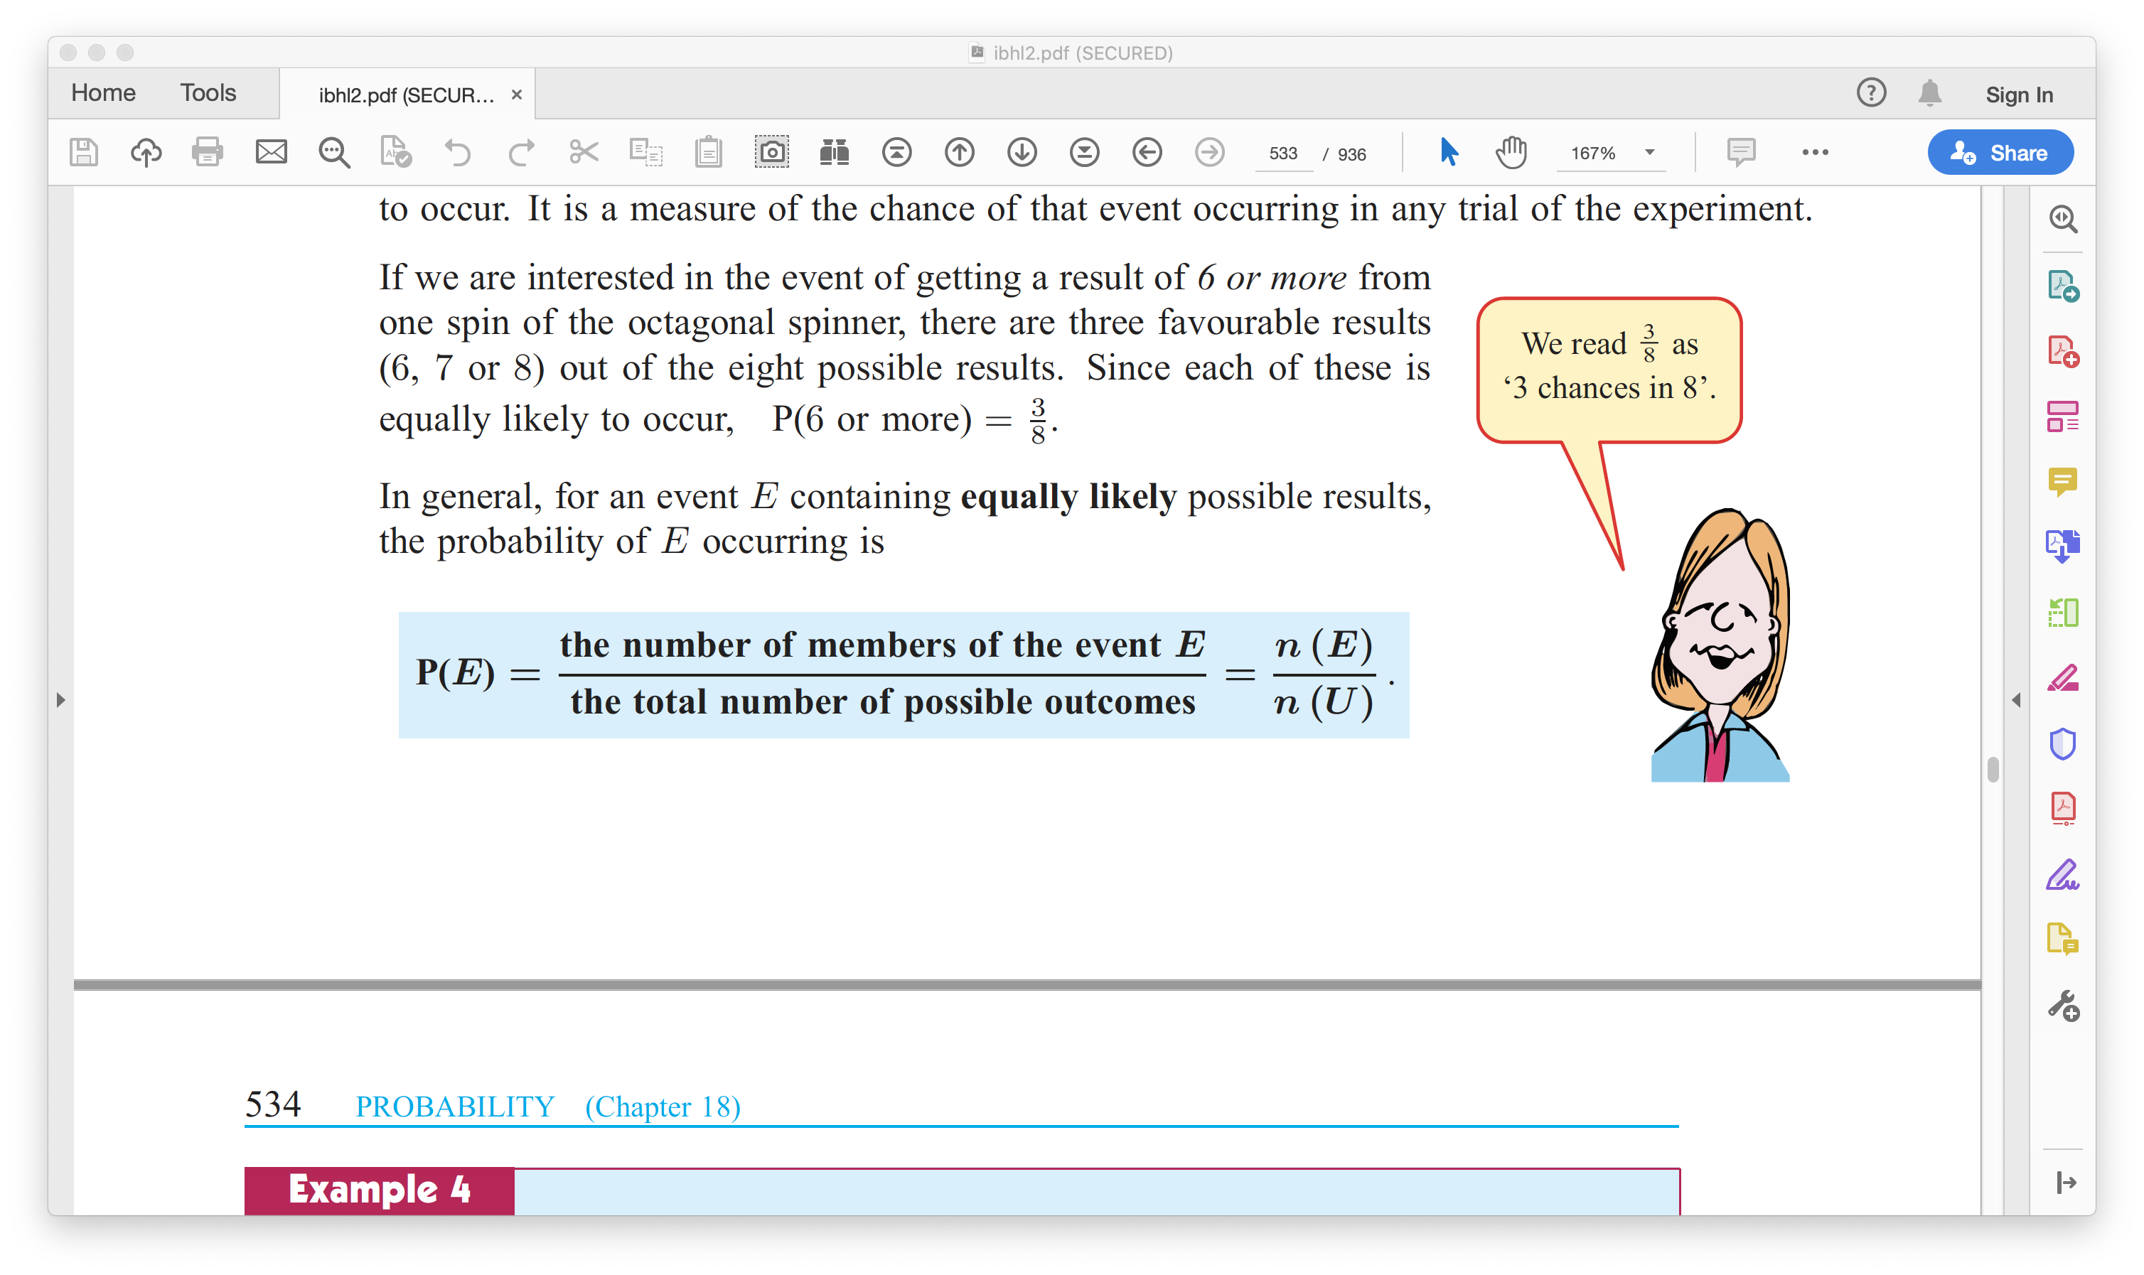
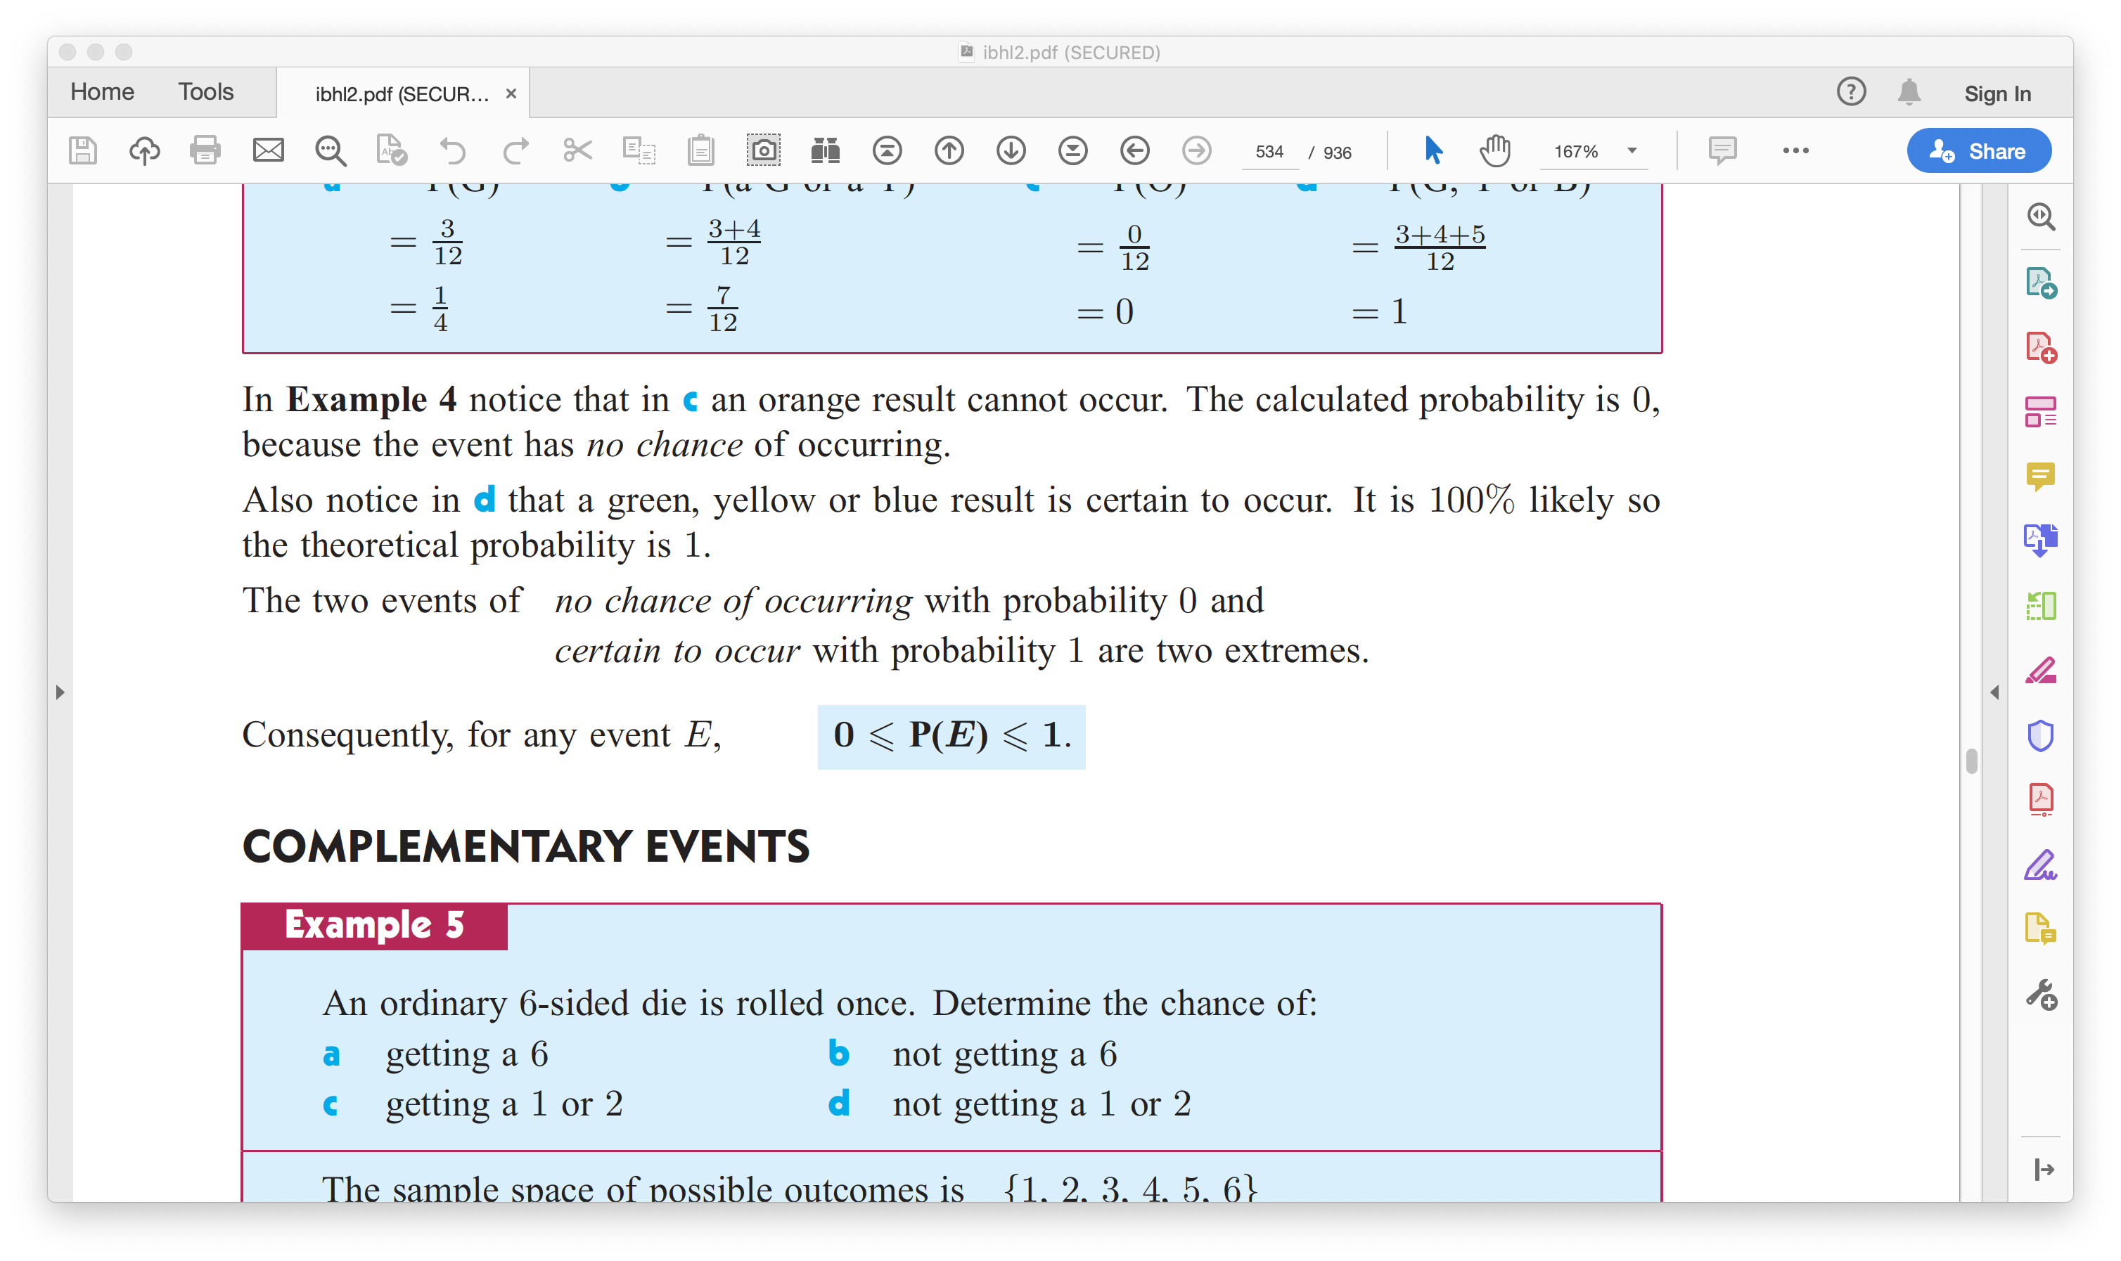
Calculating probability
Concept Development
In general, for any event E containing equally likely possible results, the probability of E occurring is

Slide 6
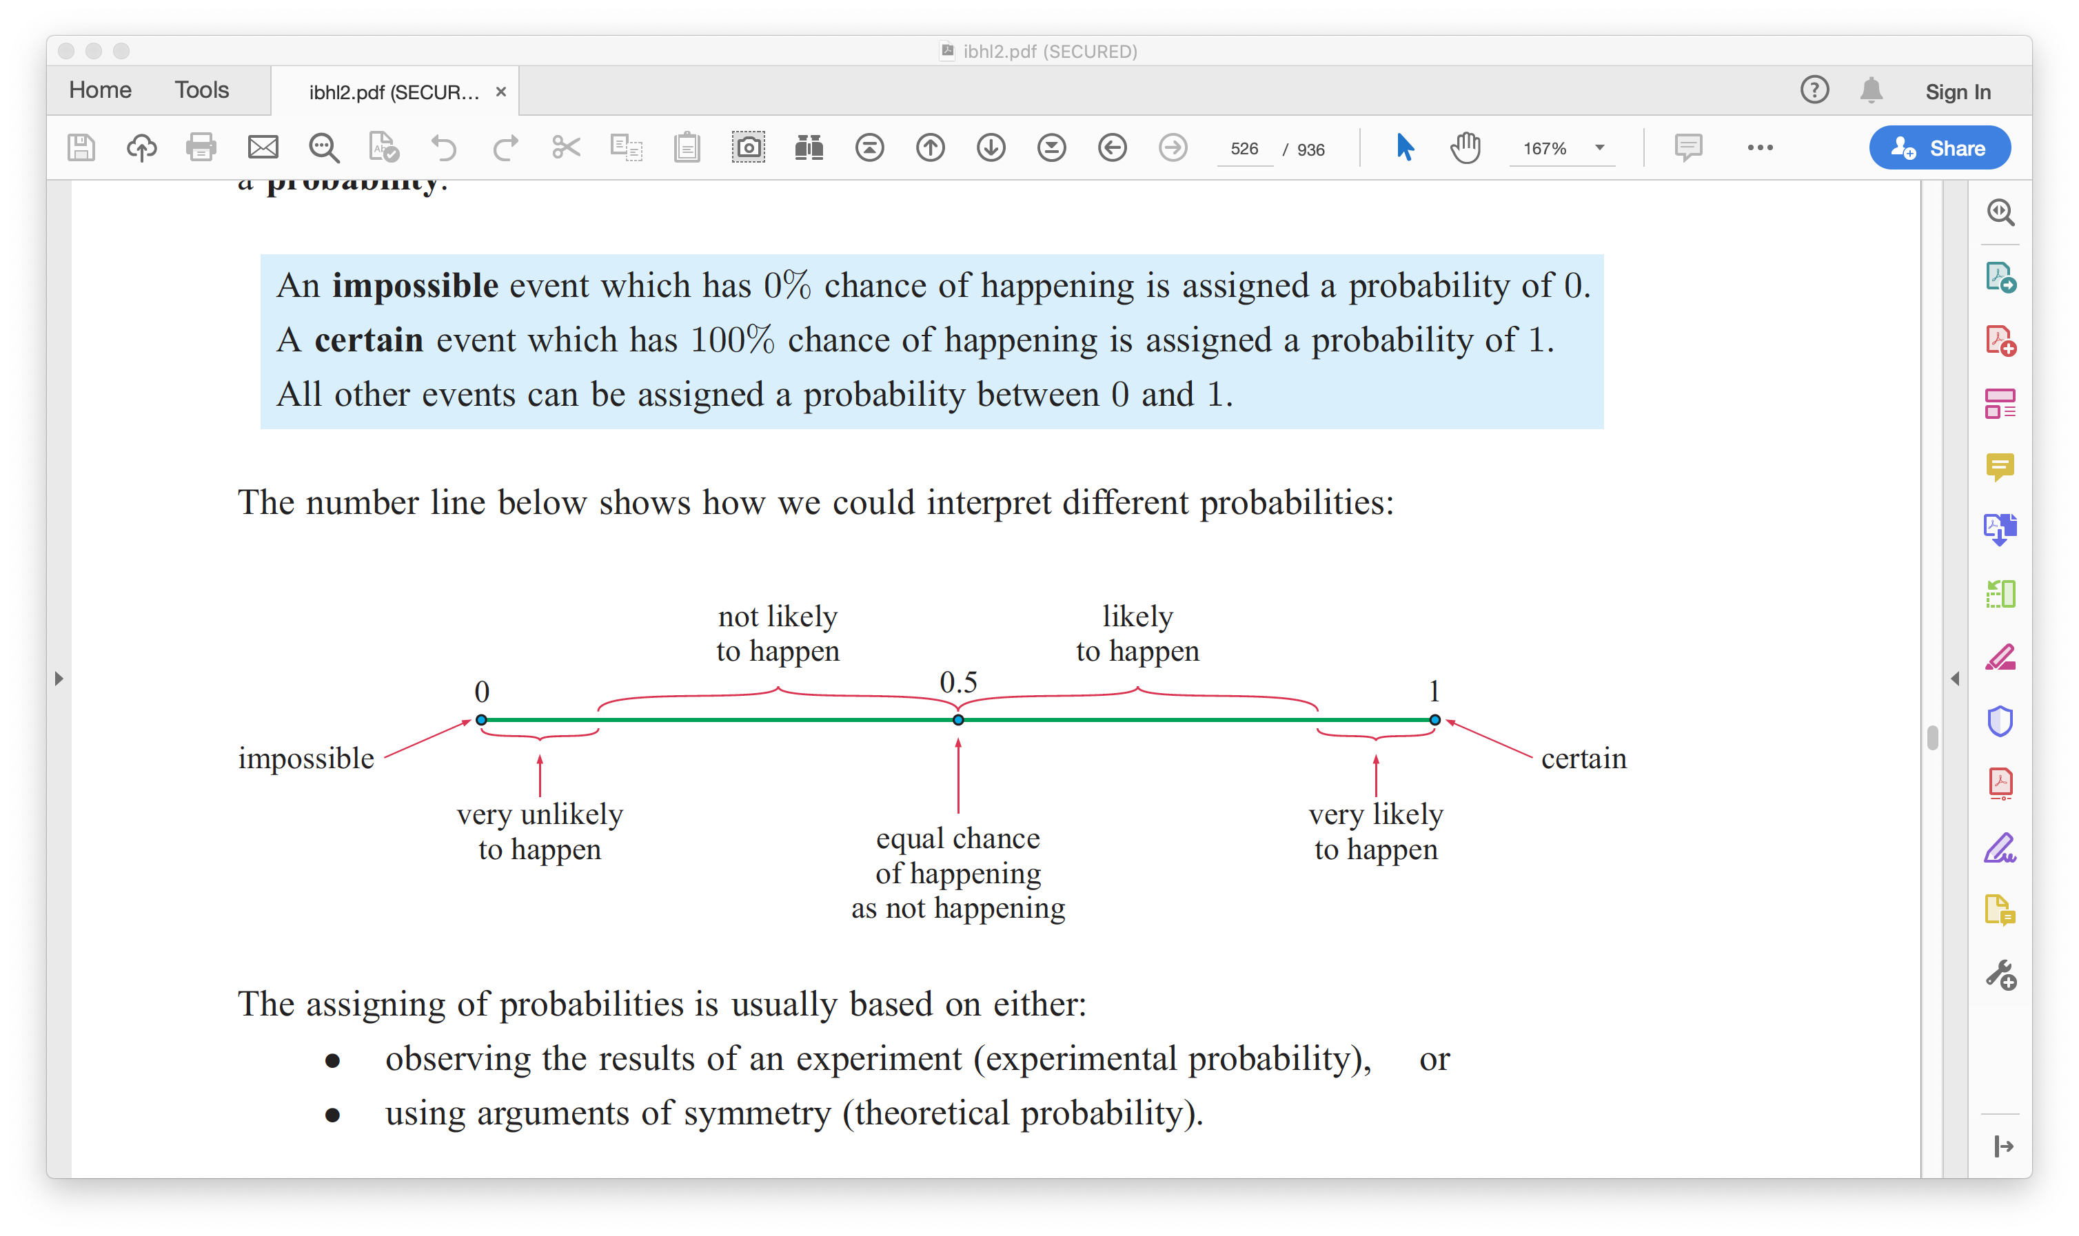
Concept Development

Slide 7
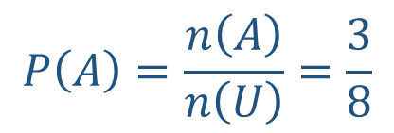

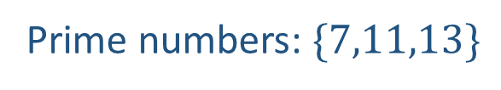
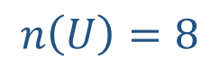
Guided Practice
Suppose a number is drawn at random from the numbers
7, 8, 9, 10, 11, 12, 13, 14. What is the probability of choosing a prime number?
$$n\left(U\right)=8$$
Prime numbers: $\{7,11,13\}$
Let $A$ be the event of choosing a Prime number
$$P\left(A\right)=\frac{n\left(A\right)}{n\left(U\right)}=\frac{3}{8}$$

Slide 8
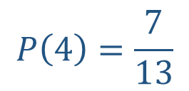
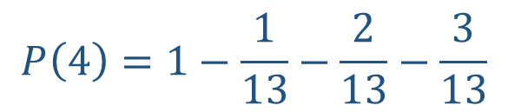
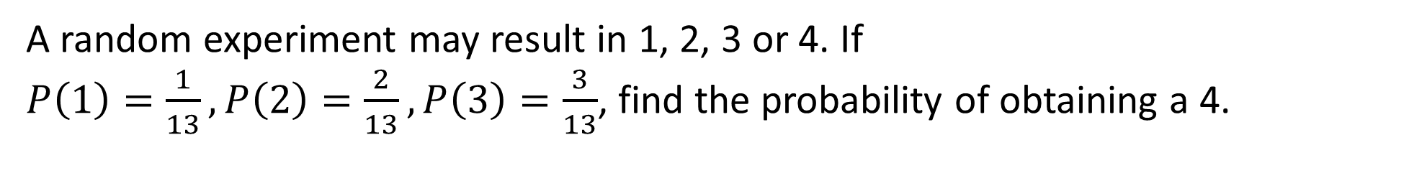
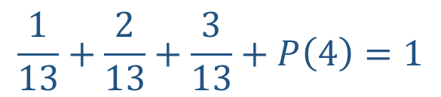
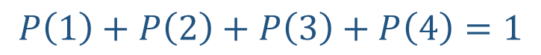
Guided Practice
A random experiment may result in 1, 2, 3 or 4. If
$P\left(1\right)=\frac{1}{13},P\left(2\right)=\frac{2}{13}, P\left(3\right)=\frac{3}{13}$, find the probability of obtaining a 4.
$$P\left(1\right)+P\left(2\right)+P\left(3\right)+P\left(4\right)=1$$
$$\frac{1}{13}+\frac{2}{13}+\frac{3}{13}+P\left(4\right)=1$$
$$P\left(4\right)=1−\frac{1}{13}−\frac{2}{13}−\frac{3}{13}$$
$$P\left(4\right)=\frac{7}{13}$$

Slide 9
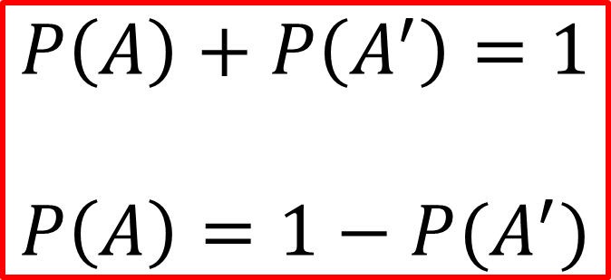
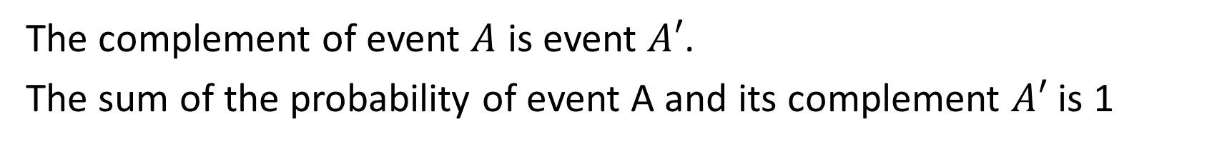
Complementary Events
Concept Development
The complement of event $A$ is event $A′$.
The sum of the probability of event A and its complement $A′$ is 1
$$P\left(A\right)+P\left(A^{′}\right)=1$$
$$P\left(A\right)=1−P(A^{′})$$

Slide 10
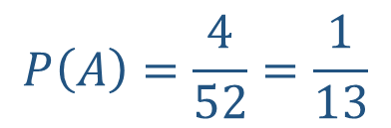

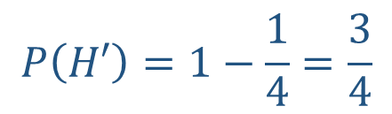
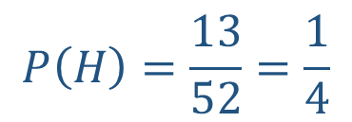

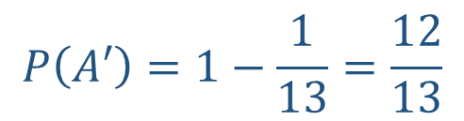
Guided Practice
A card is drawn at random from a pack of 52 cards. What is the probability that the card drawn is:
Not a heart
Not an ace?
Let $H$ be the event of drawing a heart
Let $A$ be the event of drawing an ace
$$P\left(H\right)=\frac{13}{52}=\frac{1}{4}$$
$$P\left(A\right)=\frac{4}{52}=\frac{1}{13}$$
$$P\left(H′\right)=1−\frac{1}{4}=\frac{3}{4}$$
$$P\left(A′\right)=1−\frac{1}{13}=\frac{12}{13}$$

Slide 11
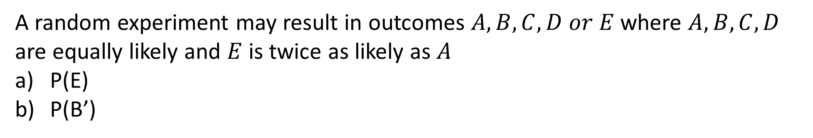
Guided Practice
A random experiment may result in outcomes $A, B, C, D or E$ where $A, B, C, D$ are equally likely and $E$ is twice as likely as $A$
P(E)
P(B’)

Slide 12
Relative Frequency
Concept Development
This is also known as experimental probability.
For example tossing a coin:
Theoretical probability of obtaining a head is 50%.
If we toss a coin for 100 times, we may have 58 times of head and hence the relative frequency (experimental probability) is 58%.
If we toss a coin for 1000 times, we may have 540 times of head and hence the relative frequency (experimental probability) is 54%.
If we toss a coin for 10 000 times, we may have 5 200 times of head and hence the relative frequency (experimental probability) is 52%

Slide 13
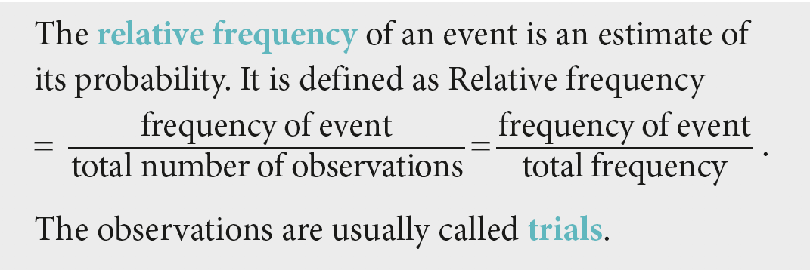
Concept Development

Slide 14
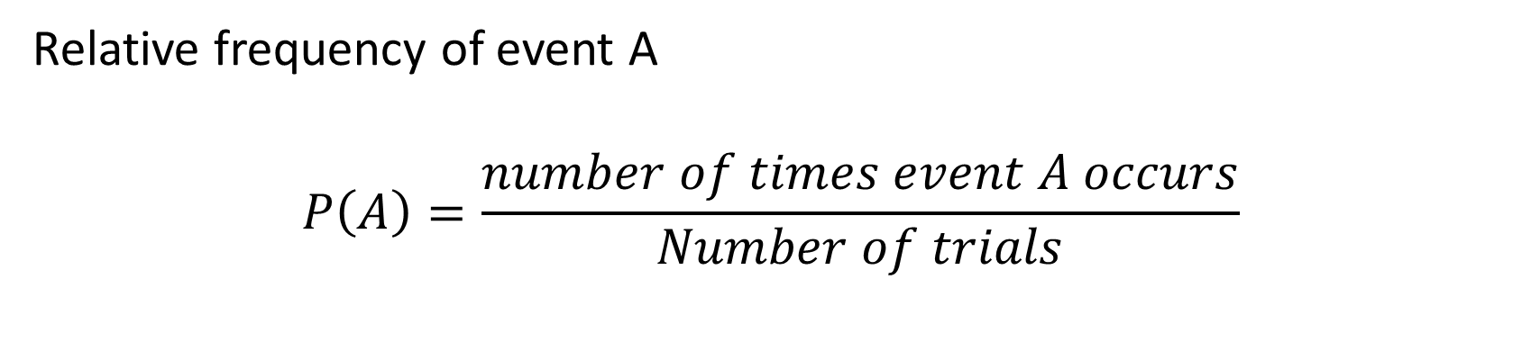
Calculating relative frequency
Concept Development
Relative frequency of event A
$$P\left(A\right)=\frac{number of times event A occurs}{Number of trials}$$

Slide 15
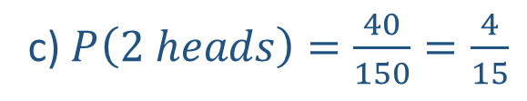
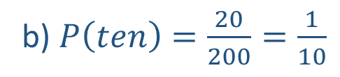
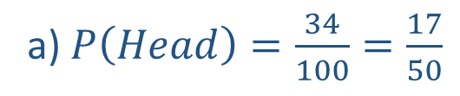
Guided Practice
Estimate the probability of the event specified occurring, using the data given:
Pr(Head) if a coin is tossed 100 times and 34 heads observed
Pr(ten) if a spinner is spun 200 times and lands on the ‘ten’ 20 times
Pr (two heads) if two coins are tossed 150 times and two heads are observed on 40 occasions.
a) $P\left(Head\right)=\frac{34}{100}=\frac{17}{50}$
b) $P\left(ten\right)=\frac{20}{200}=\frac{1}{10}$
c) $P\left(2 heads\right)=\frac{40}{150}=\frac{4}{15}$

Slide 16
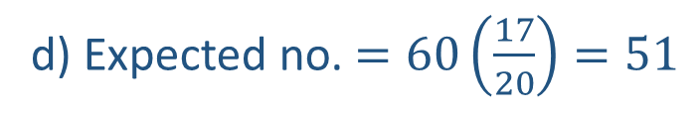
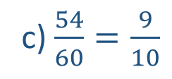
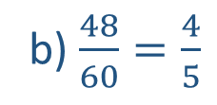
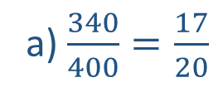
Guided Practice
A bowl contains 340 red and 60 black balls:
State the proportion of red balls in the bowl
A random sample of 60 balls is taken from the bow and is found to have 48 red balls. Find the proportion of red balls in the sample.
Another random sample of 60 balls is taken from the bowl and is found to have 54 red balls. Find the proportion of red balls in the sample.
What is the expected number of red balls in a sample of 60?
a) $\frac{340}{400}=\frac{17}{20}$
b) $\frac{48}{60}=\frac{4}{5}$
c) $\frac{54}{60}=\frac{9}{10}$
d) Expected no. $=60\left(\frac{17}{20}\right)=51$

Slide 17
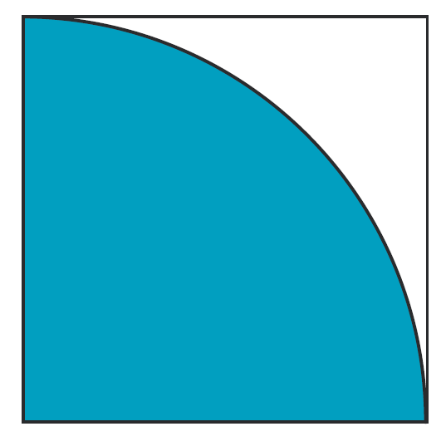
Guided Practice
A square of side length 1 m contains a blue one-quarter of a circular disc centred at the bottom-left vertex of the square.
What proportion of the square is blue? Leave your answers in exact form.

Slide 18
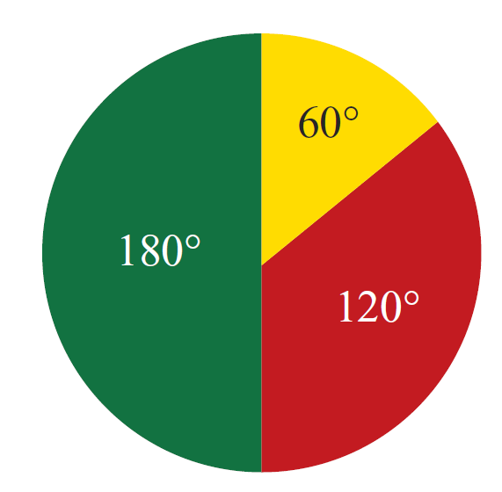
Guided Practice
A spinner is as shown in the diagram.
Find the probability that when spun, the pointed will land on
The red section
The yellow section
Any section except the yellow section.

Slide 19
Independent Practice
Complete Ex 9A & 9B

